Slide 1


Koopman Analysis of Large-Scale Transient Simulation Data on Weather Dynamics
Zhicheng Zhang*
Joint work with Yoshihiko Susuki* and ${\text{Atsushi} \text{Okazaki}}^{†}$
*Department of Electrical Engineering, Kyoto University
${}^{†}$Institute of Advanced Academic Research, Chiba University
SIAM Conference on Applications of Dynamical Systems
(SIAM DS’25)
May 13, 2025, Denver

Slide 2
Purpose and Outline of Presentation
Q1: Can we capture a dominant (e.g., transient) Koopman mode embedded in a large-scale and short-term simulation data?
Q2: Which types of pattern should we focus on such that model-reduction?
Motivations and Previous Works
Data Source (Short-Time High-Dim. Weather Dynamics)
Methods (KMD, DMD, Sparsity-Promoting DMD)
Experiments on Different Observed Data Fields (Extract Transient Modes in Terms of Bubble-Like Patterns)
Summary

Slide 3
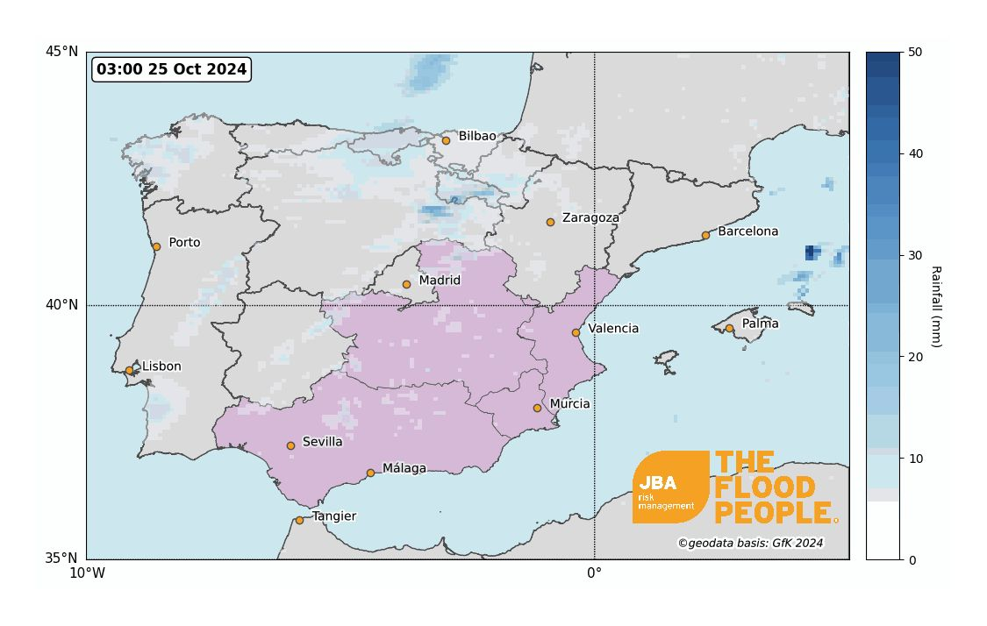
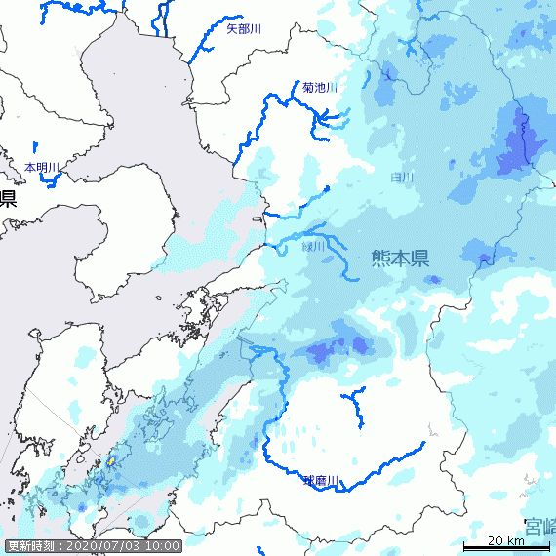
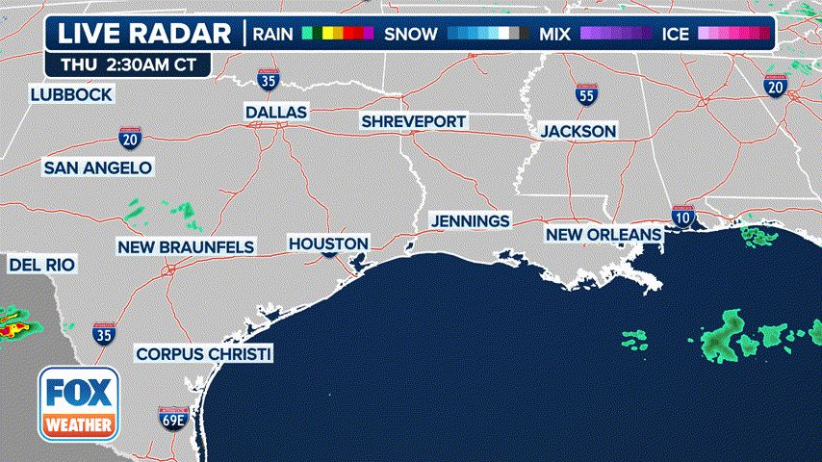
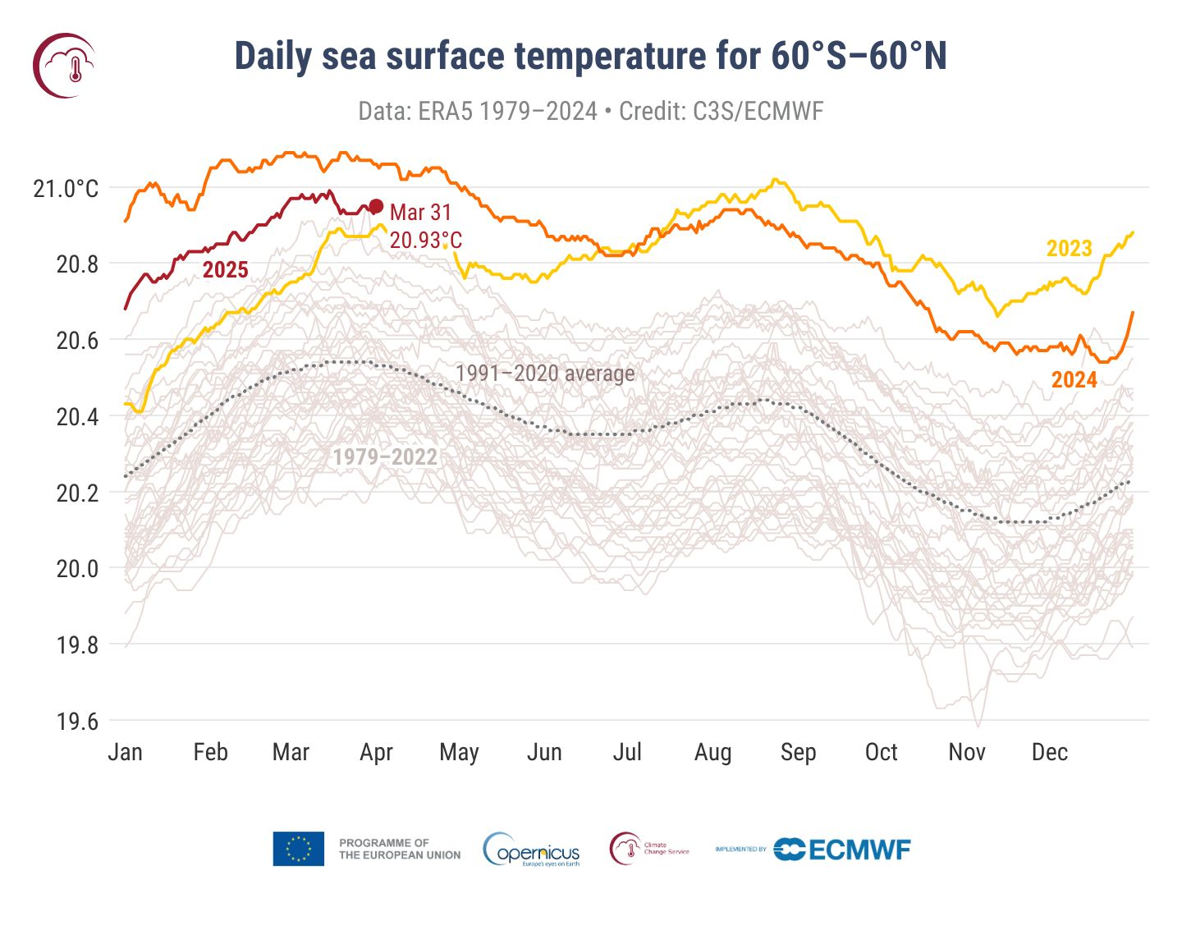
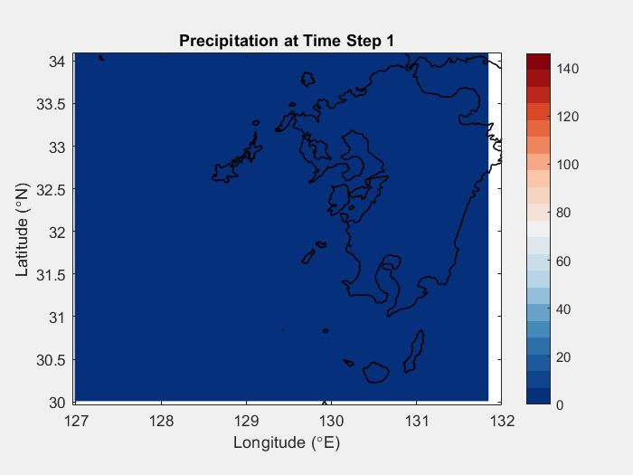
Heavy Rain-full Impacts: Floods, Climate Changes,…
A 3-hour radar loop showing where showers and thunderstorms are ongoing (Omega blocking pattern, Flood threat across Southeast, in next few days…)
2024 Spanish floods Oct. (torrential rain caused by an isolated low-pressure)
2020 Kyushu floods (heavy rain of July)
“East Asian rainy season: Tsuyu”
Short-term Weather systems (Transient dynamics, e.g.,12-hours)

Slide 4
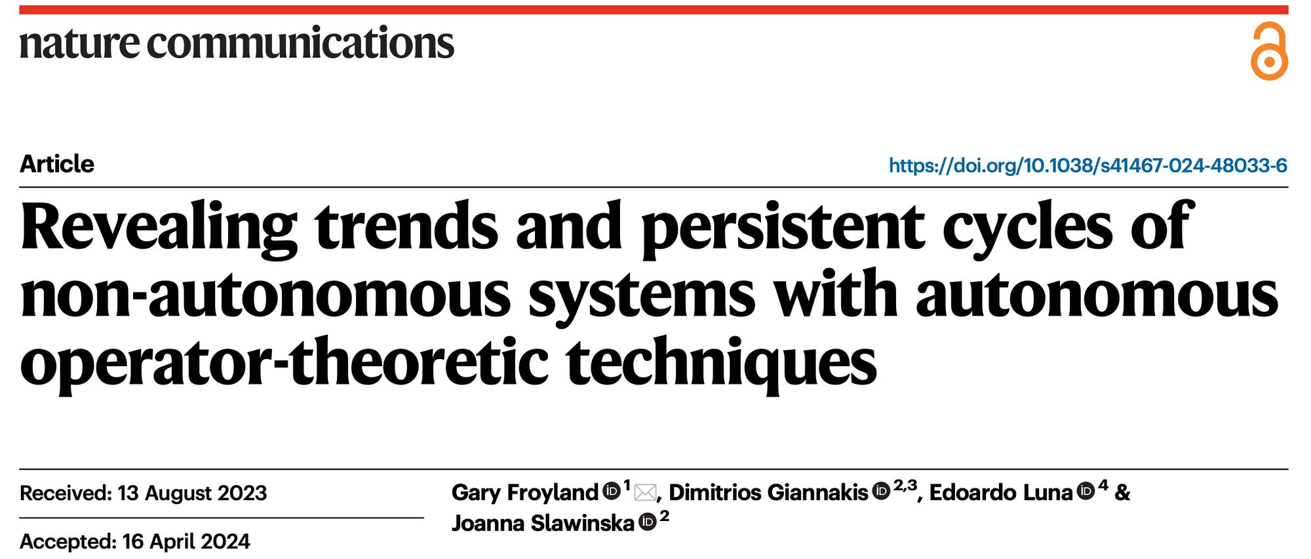

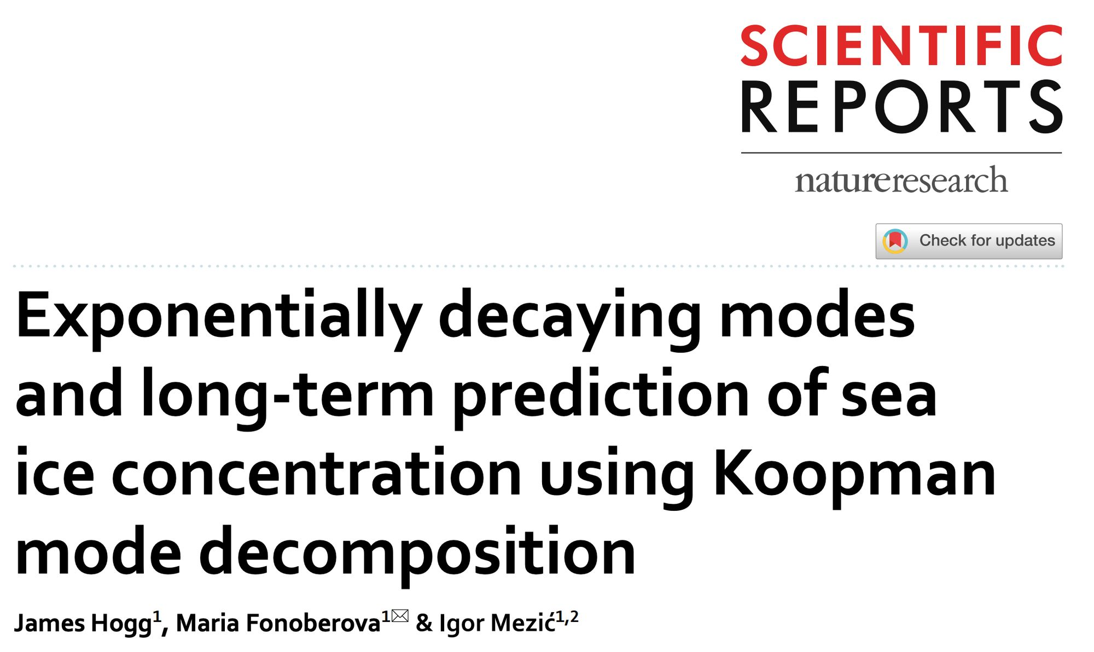
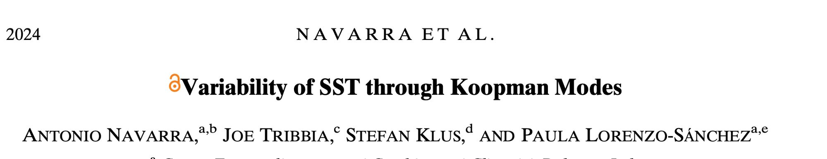
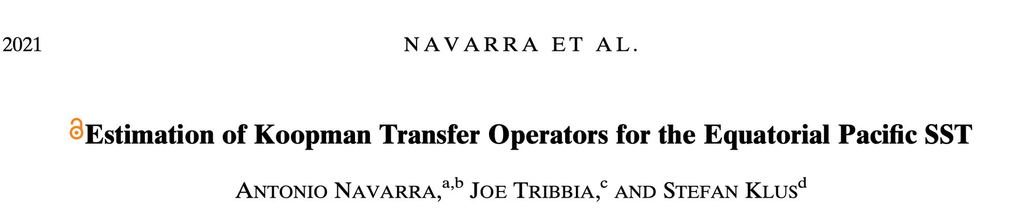
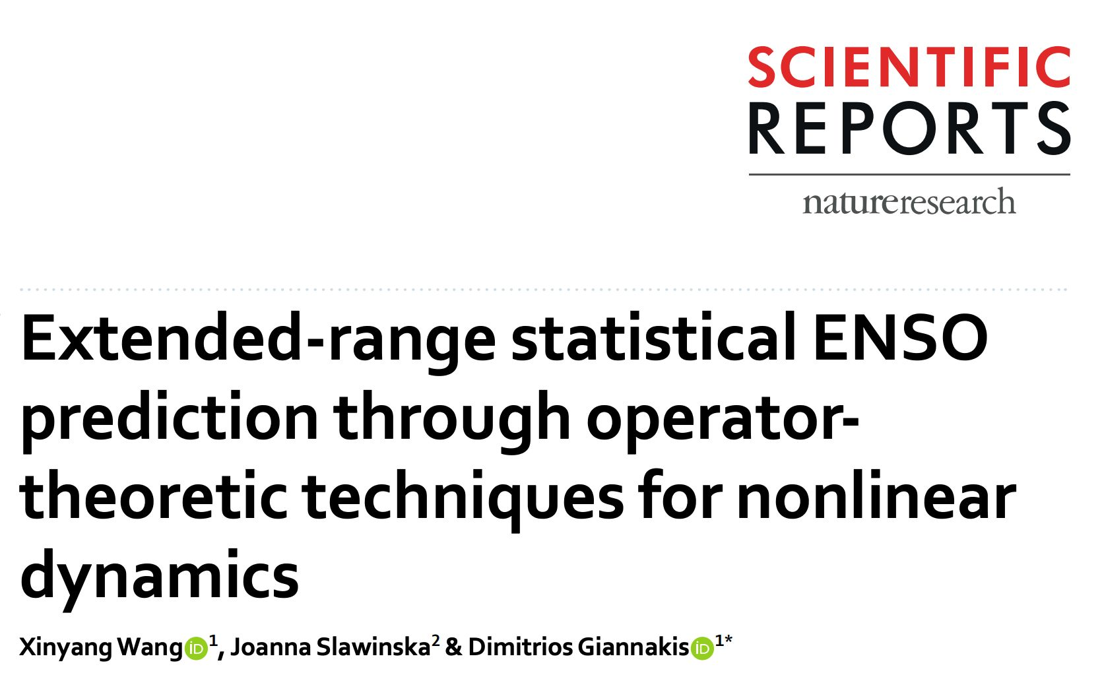
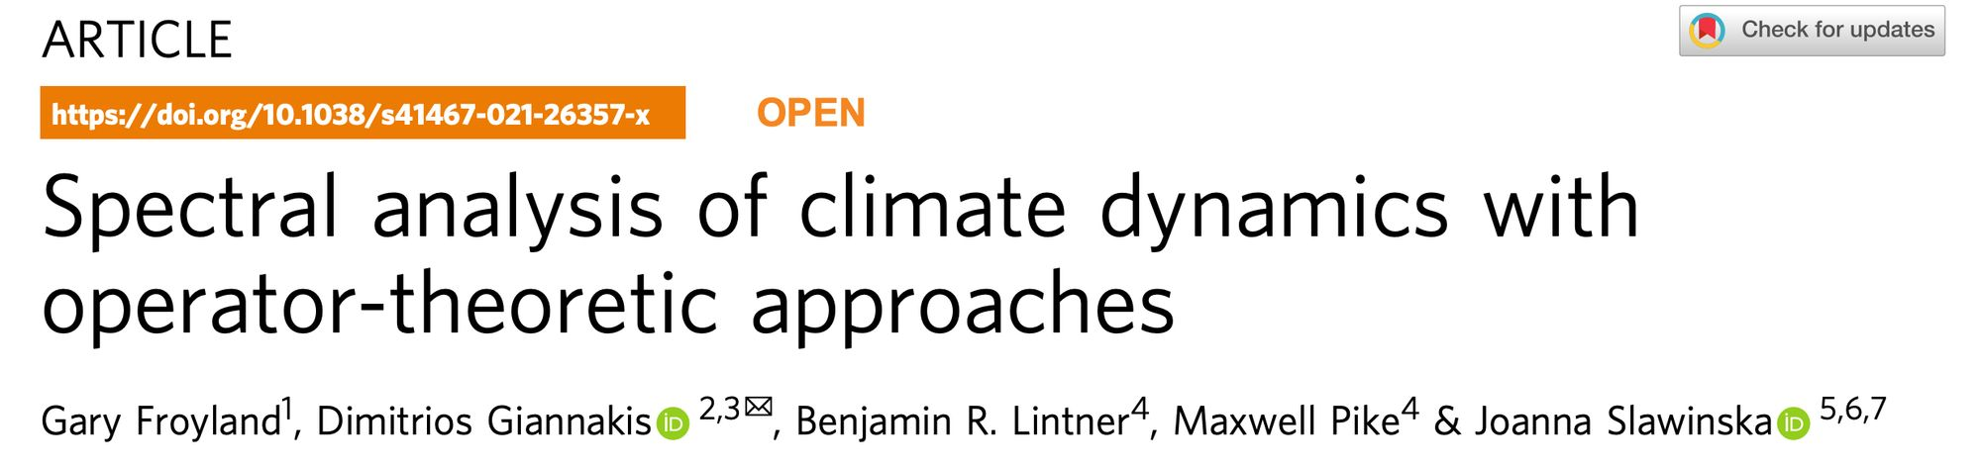
Previous Works on Climate or Weather Systems
However, fewer studies have focused on short-term weather systems, which are governed by transient dynamics.
……

Slide 5

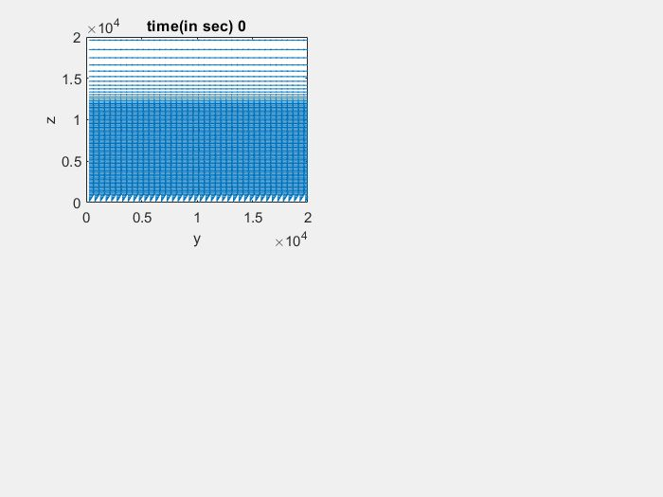



Data Source: SCALE Weather Simulation Data*
3D
$$z$$
2D
$$x$$
Vertical z-direction
(data.W)
Distance 20 km with 97 grids
$$z$$
$$y$$
$$y$$
$$x$$
Horizontal y-direction (data.V)
Distance 20 km with 40 grids
y-z plane:
40 x 97 = 3880 grids
SCALE Weather dynamics Simulation
Time unit: 30 sec. ( or 0.5 min) per iteration
Original data :
N=121 snapshots (1-hour) and 3380 grids
*Ref.) SCALE: Scalable Computing for Advanced Library and Environment, RIKEN, url: https://scale.riken.jp

Slide 6
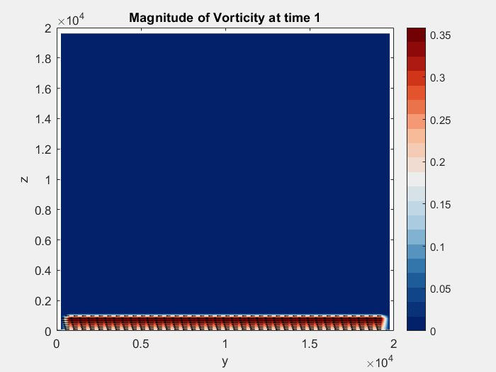
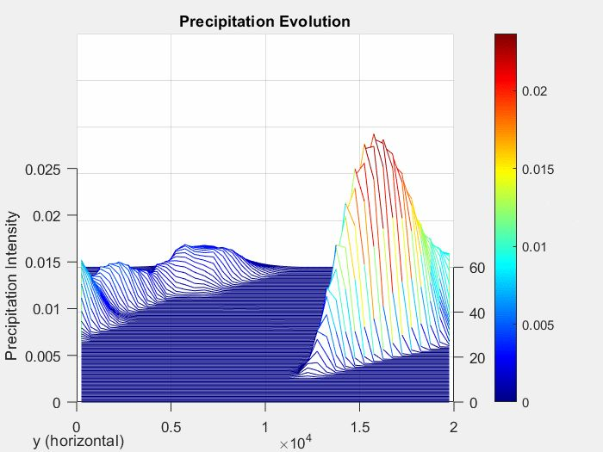
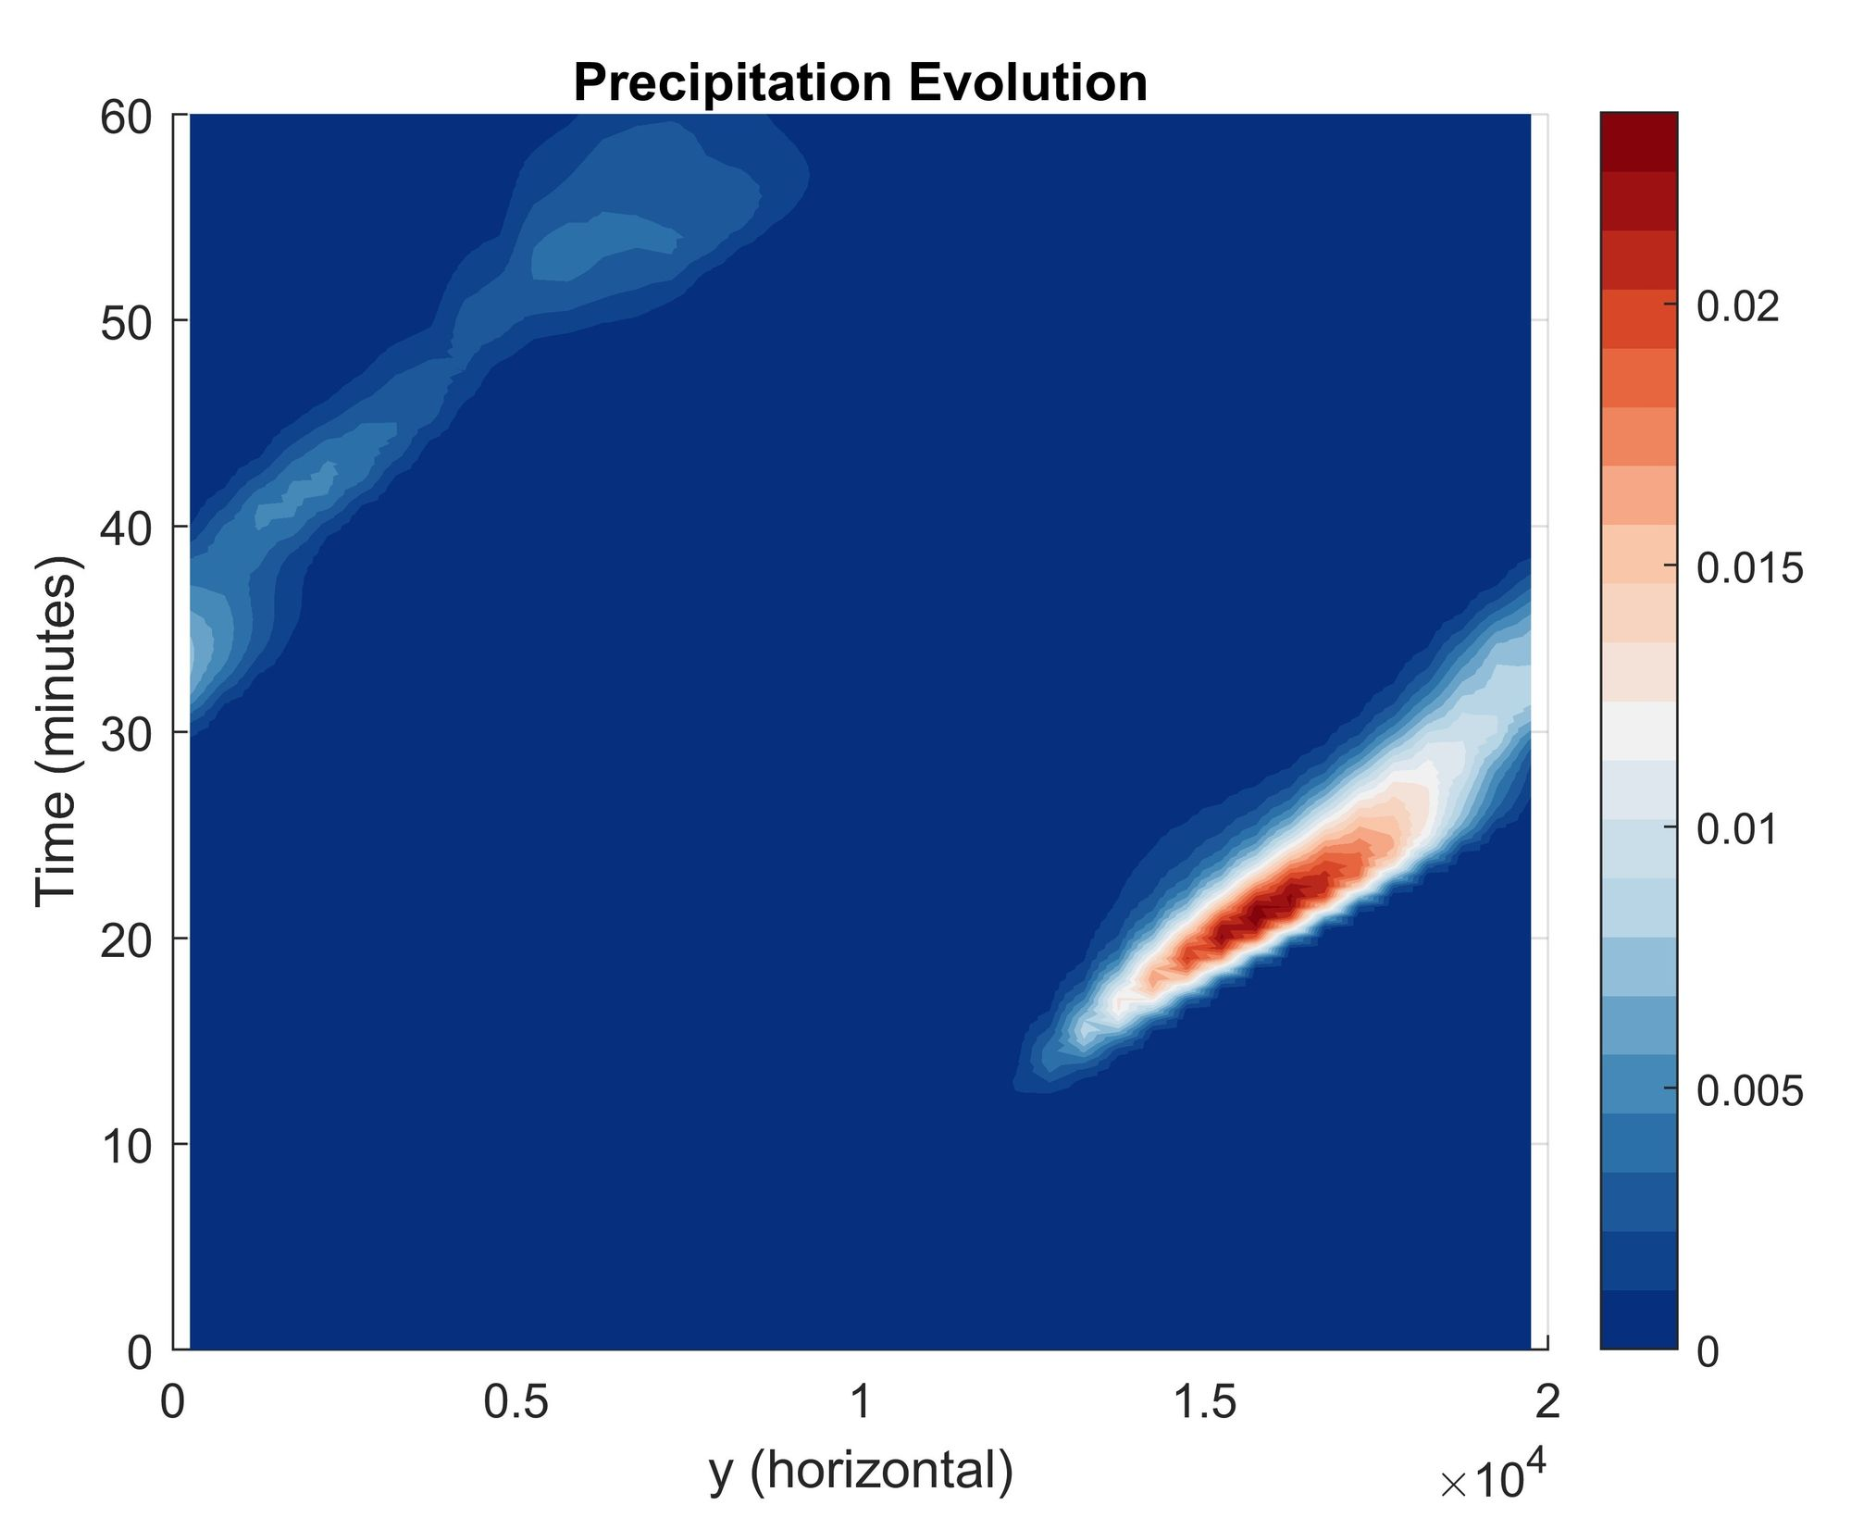
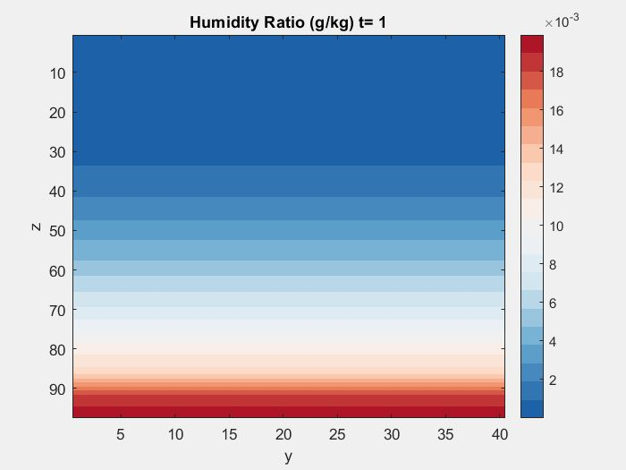
Data Fields: Vorticity Magnitude, Humidity Ratio, Precipitation
?:Warm bubble-like structure
Precipitation in 3D and 2D that is closely related to bubble-like structures
What we intend to do:
Extract dominant transient modes with ? structures from weather simulations across ‘different observable data spaces’ to reveal growth or decay of heavy rainfall (precipitation)

Slide 7
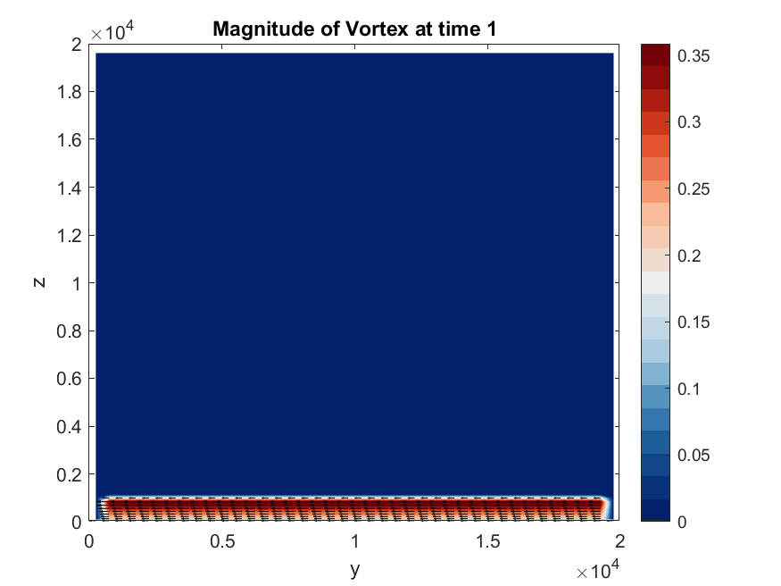
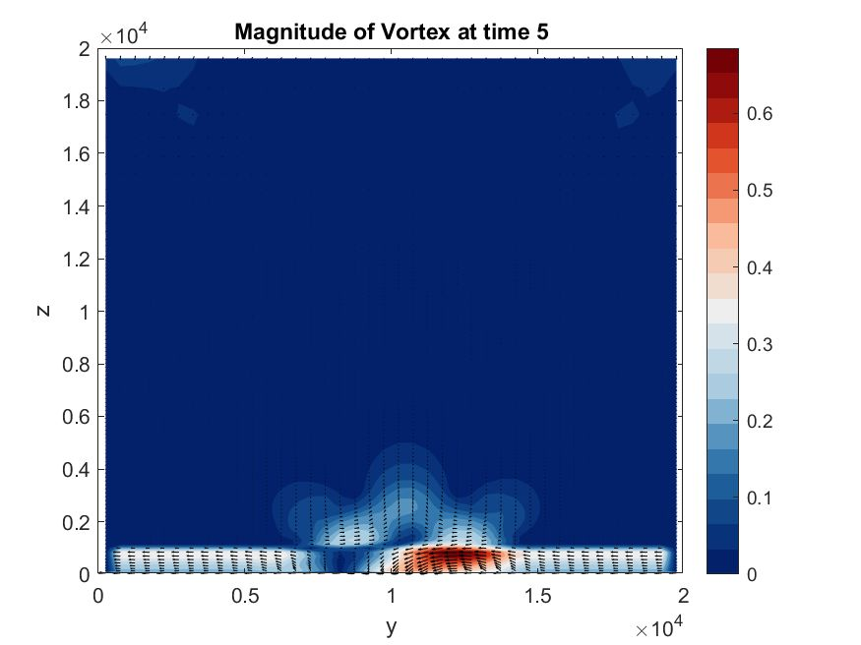
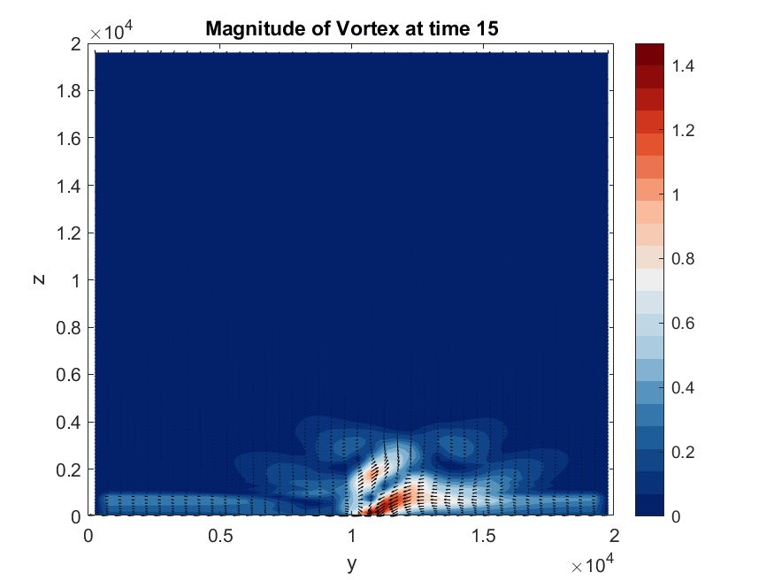
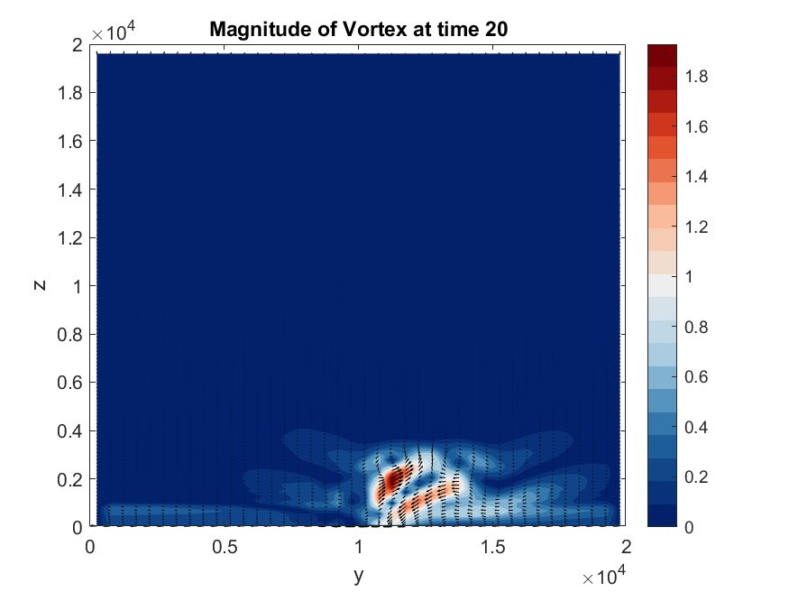
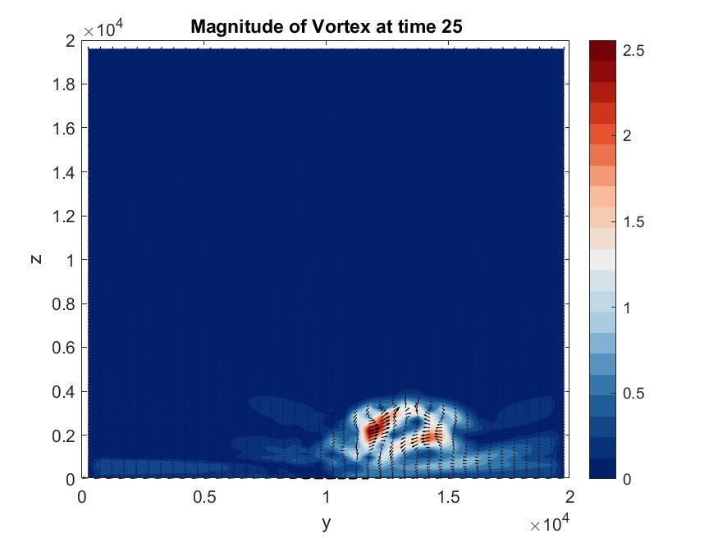
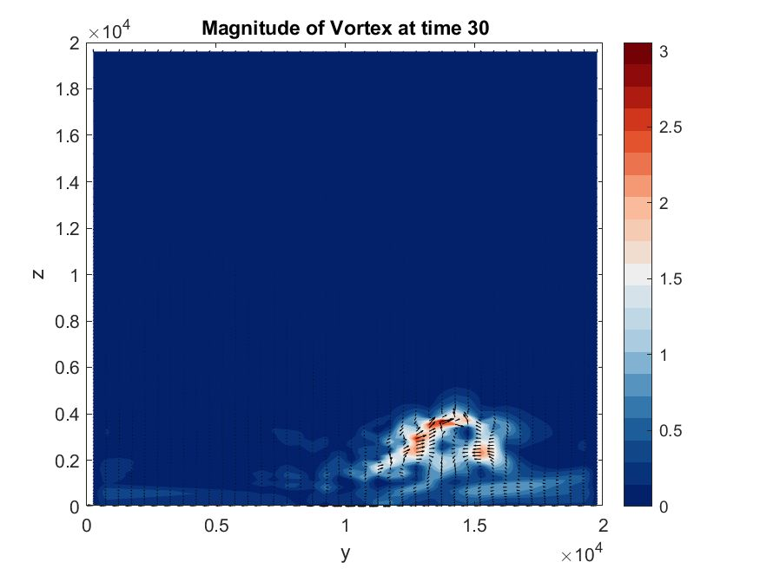
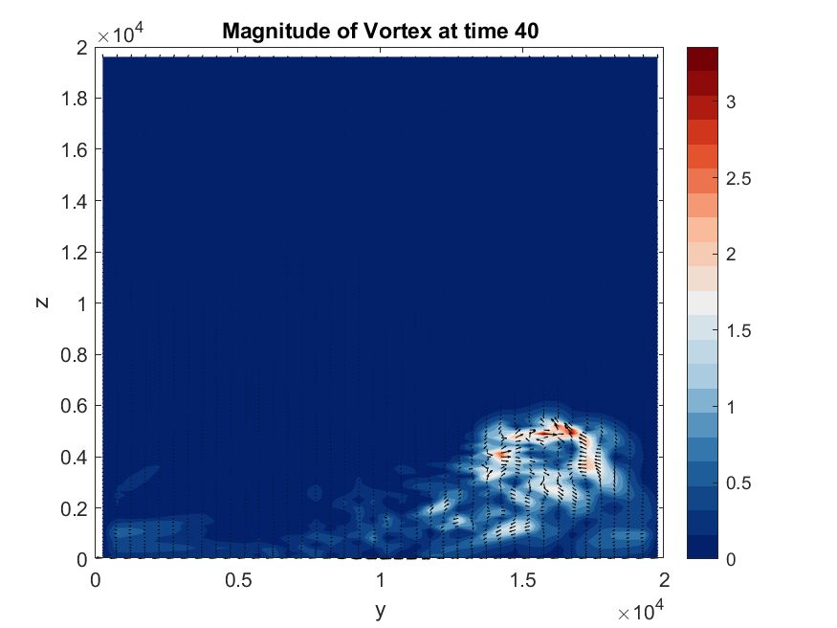
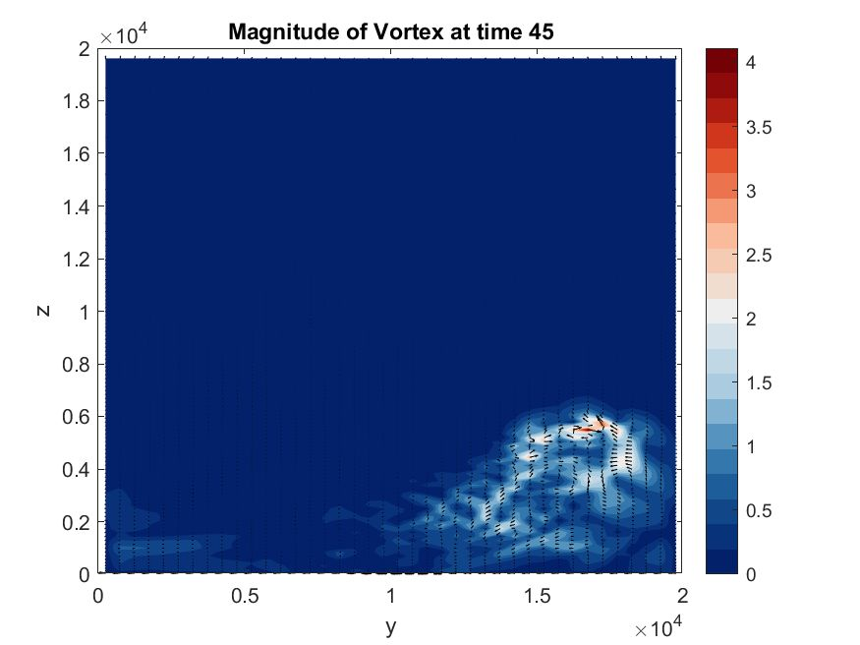
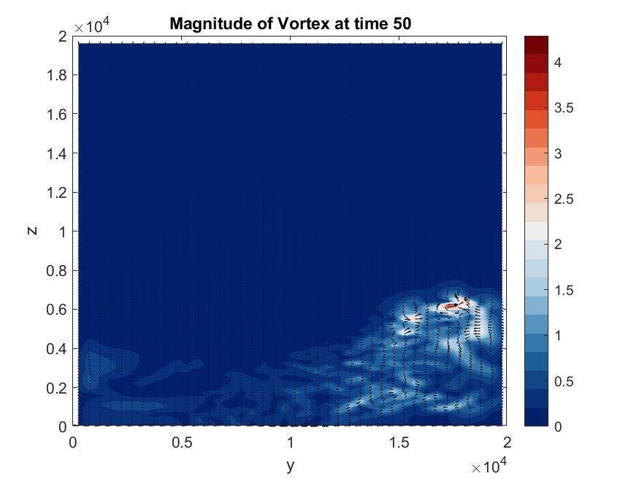
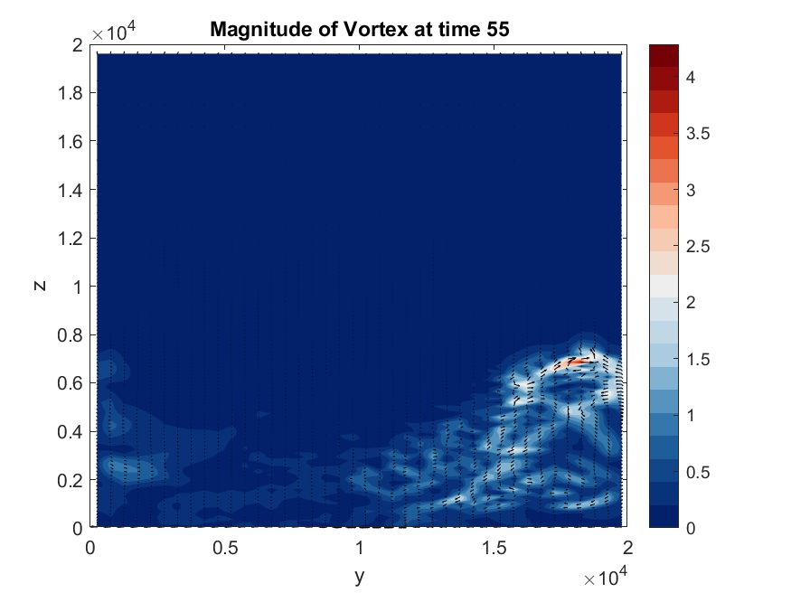
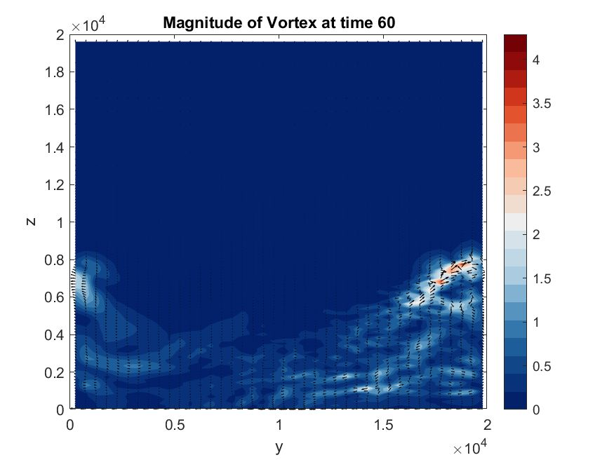
Partially Original Snapshots: Warm Bubble-Like Patterns
Intuitively, a warm-bubble-like pattern goes upward…

Slide 8
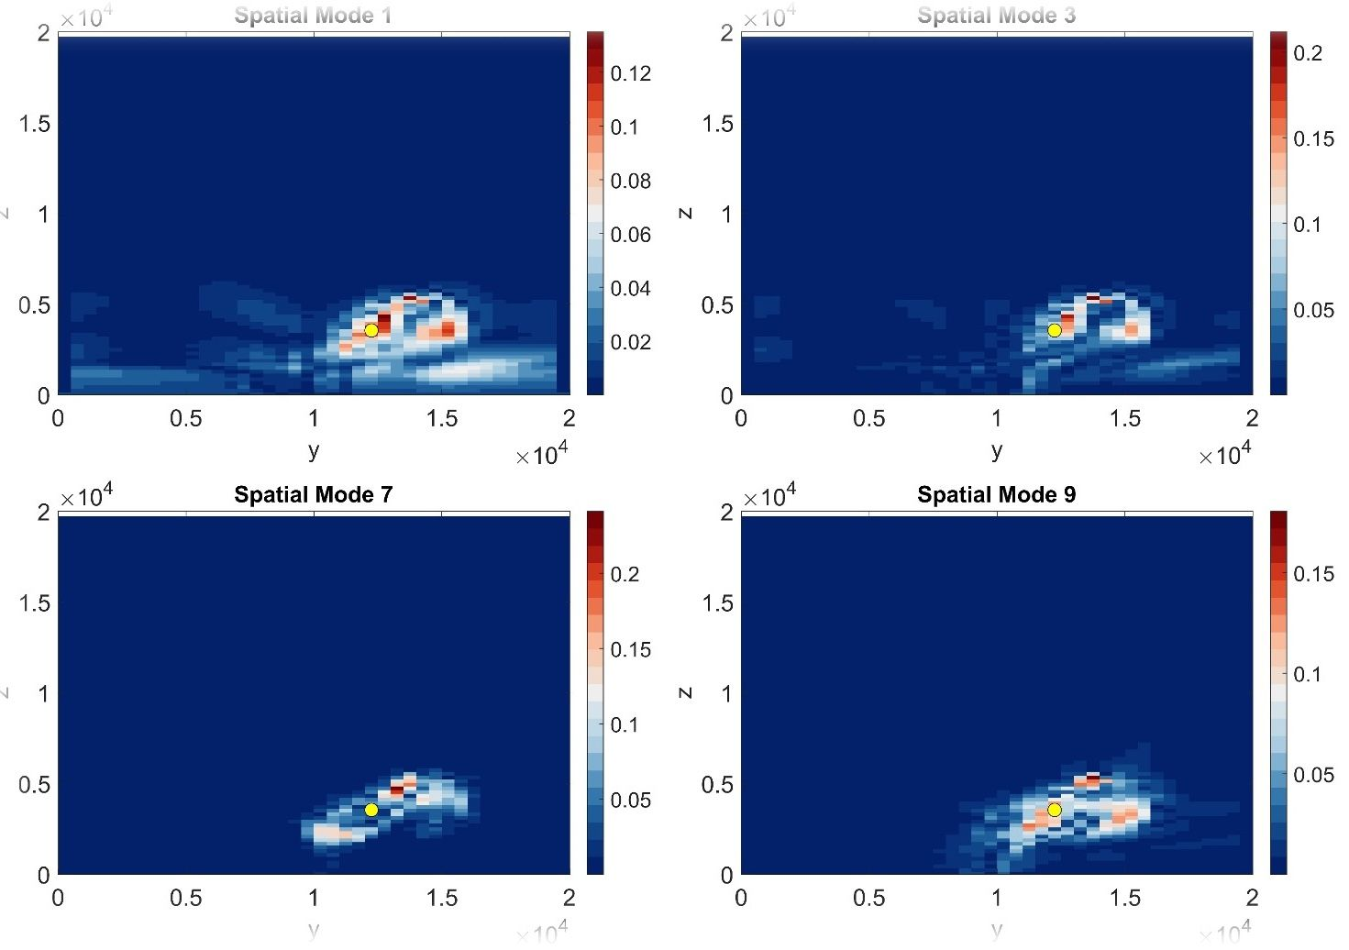
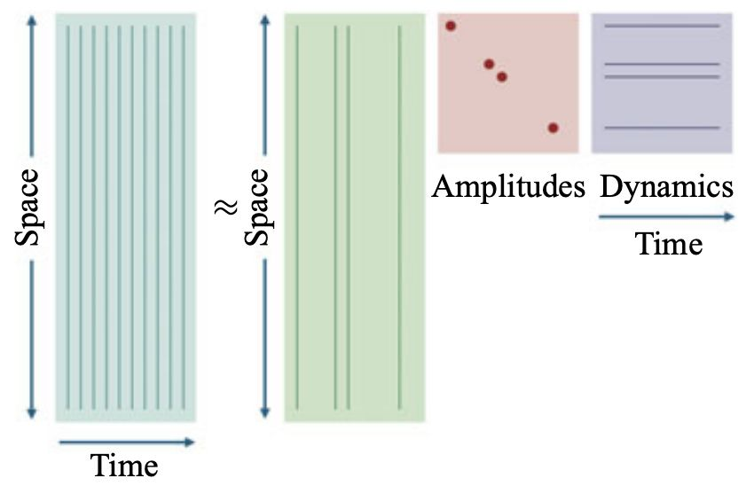
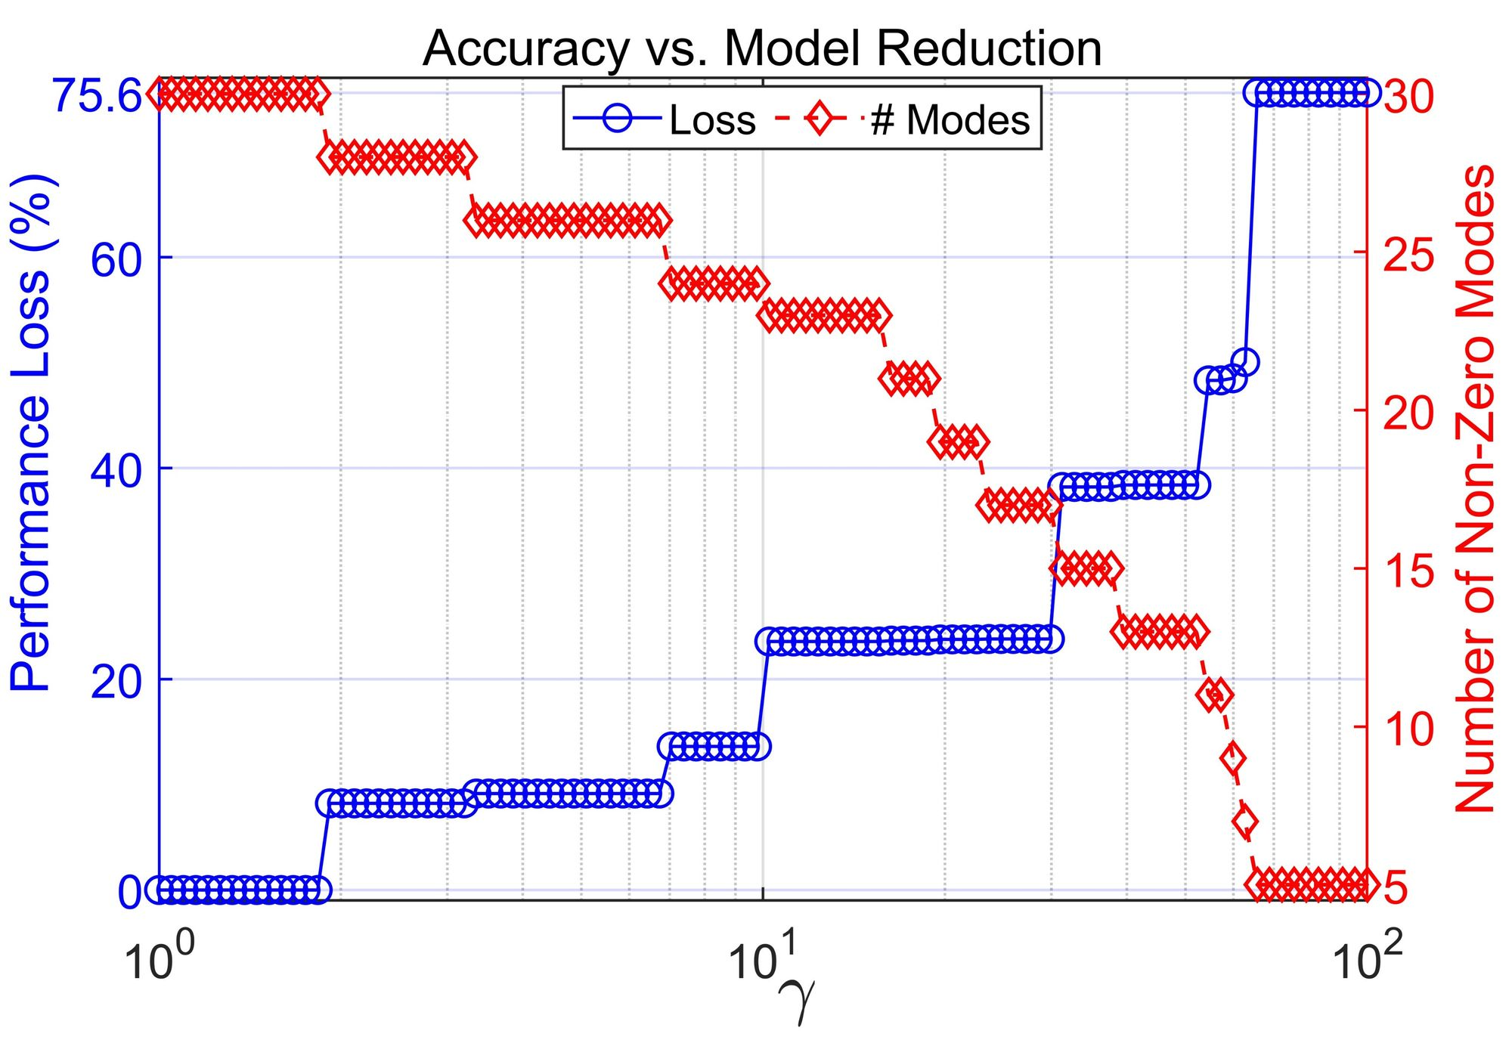
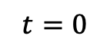
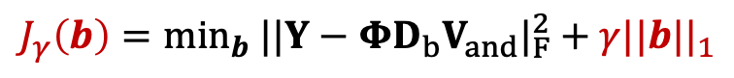
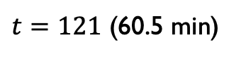
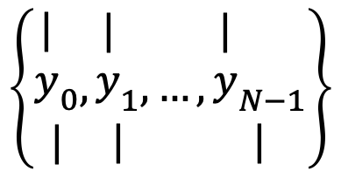
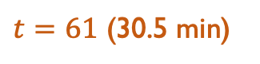
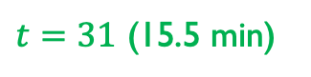
Roadmap of Bubble-like Pattern Extraction
Initial-term
Mid-term
Short-term dynmaics
[.............................]...........................]. ]
$$t=0$$
$t=31$ (15.5 min)
$t=61$ (30.5 min)
$t=121$ (60.5 min)
Sparse
Snapshots
SPDMD
$$\left\{\begin{aligned}{\begin{aligned}| \\ y\end{aligned}}_{0} \\ |\end{aligned},\begin{aligned}{\begin{aligned}| \\ y\end{aligned}}_{1} \\ |\end{aligned},…,\begin{aligned}{\begin{aligned}| \\ y\end{aligned}}_{N−1} \\ |\end{aligned}\right\}$$
$$J_{γ}\left(b\right)=\min_{b} ||Y−ΦD_{b}V_{and}|_{F}^{2}+γ||b||_{1}$$
Balance Accuracy
& Complexity
Ref.) Jovanovic et. al, Physics of Fluids’14

Slide 9
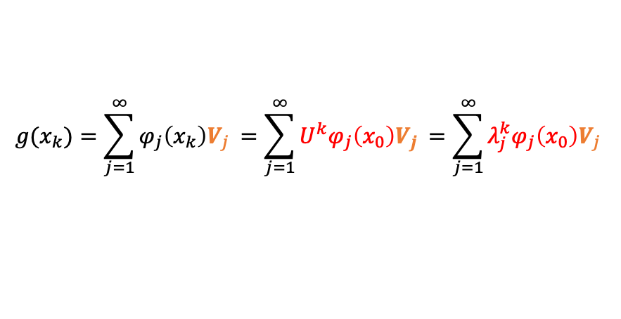
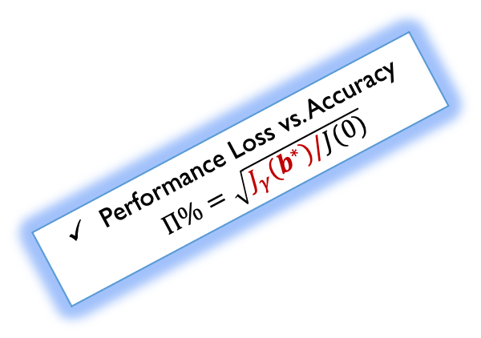


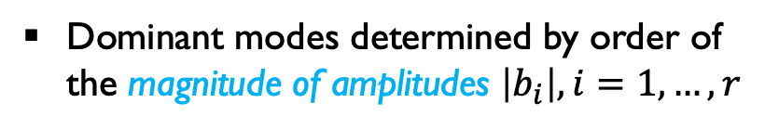
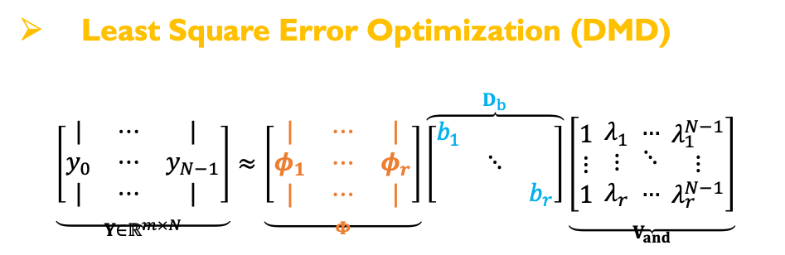

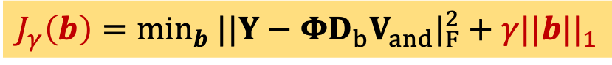
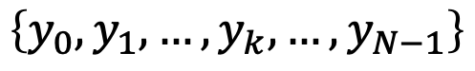


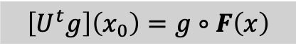
Methods: Koopman and Dynamic Mode Decompositions
Ref.) Mauroy, Mezic & Susuki, The Koopman Operator in Systems and Control, Springer’20
Koopman mode decomposition (KMD)
Dynamic mode decomposition (DMD)
Refs.) Kutz et. al, Dynamic mode decompotion,SIAM’16;….
$$x_{k+1}=F\left(x_{k}\right),$$
$$y_{k}=g(x_{k})$$
FINITE-LENGTH TIME-SERIES DATA
$$\left\{y_{0},y_{1},…,y_{k},…,y_{N−1}\right\}$$
$$\left[U^{t}g\right]\left(x_{0}\right)=g∘F\left(x\right)$$
$$y_{k}≈\sum_{j=1}^{N}{φ_{j}λ_{j}^{k}b_{j}}$$
SVD
$$y_{k}≈\sum_{j=1}^{r}{φ_{j}λ_{j}^{k}b_{j}}$$
$$g(x_{k})=\sum_{j=1}^{∞}{φ_{j}\left(x_{k}\right)V_{j }}=\sum_{j=1}^{∞}{U^{k}φ_{j}\left(x_{0}\right)V_{j }}=\sum_{j=1}^{∞}{λ_{j}^{k}φ_{j}\left(x_{0}\right)V_{j }}$$
Finite-dim. approximation
$$J\left(b\right)=\min_{b} ||Y−ΦD_{b}V_{and}||_{F}^{2}$$
Sparsity-Promoting DMD: SPDMD
Performance Loss vs. Accuracy $Π\%=\sqrt{J_{γ}(b^{∗})/J(0)}$
Least Square Error Optimization (DMD)
$$\underset{Y∈ℝ^{m×N}}{\underbrace{\left[\begin{matrix}| & ⋯ & | \\ y_{0} & ⋯ & y_{N−1} \\ | & ⋯ & |\end{matrix}\right]}}≈\underset{Φ}{\underbrace{\left[\begin{matrix}| & ⋯ & | \\ φ_{1} & ⋯ & φ_{r} \\ | & ⋯ & |\end{matrix}\right]}}\overset{D_{b}}{\overbrace{\left[\begin{matrix}b_{1} & & \\ & ⋱ & \\ & & b_{r}\end{matrix}\right]}}\underset{V_{and}}{\underbrace{\left[\begin{matrix}1 \\ ⋮ \\ 1\end{matrix} \begin{matrix}λ_{1} \\ ⋮ \\ λ_{r}\end{matrix} \begin{matrix}… \\ ⋱ \\ …\end{matrix} \begin{matrix}λ_{1}^{N−1} \\ ⋮ \\ λ_{r}^{N−1}\end{matrix}\right]}}$$
$$J_{γ}\left(b\right)=\min_{b} ||Y−ΦD_{b}V_{and}|_{F}^{2}+γ||b||_{1}$$
Spatial Modes
Temporal Modes
Dominant modes determined by order of the magnitude of amplitudes $\left|b_{i}\right|, i=1,…,r$
Amplitudes
Penalize an ℓ1 norm on the amplitudes
Ref.) Jovanovic et. al, Physics of Fluids’14

Slide 10
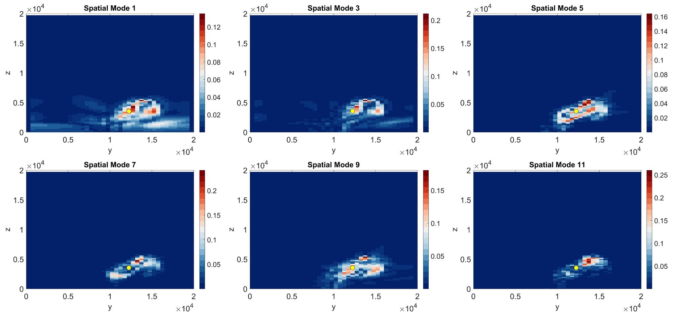





Experiment I: Initial term of Vorticity Magnitude (N=31)
Initial-term Vorticity Magnitude: Y$∈ℝ^{3880×31}$
DMD vs. SPDMD
Extract 6 paired decay or growth modes
$$|φ_{j}|$$
$$ℜe(λ_{j}^{k}b_{j})$$

Slide 11

Performance Assessments:
Superposition evolution
Specific spatial location (25, 26) ≈ (12.5km, 5.4km)
SPDMD makes a trade off between accuracy and model complexity.
However, SPDMD with few selected modes can not directly capture the peak / jump of temporal dynamics (vs. original data)

Slide 12





Experiment 1: Mid-term of Vorticity Magnitude (N=61)
Mid-term Simulation
$$Y∈ℝ^{3880×61}$$
SPDMD
Specific Spatial location (30, 38) ≈ (15km, 7.8km) with the index i=1510 may fail to jump behavior

Slide 13


Performance Loss vs Model Reduction:
SPDMD makes a trade-off between the accuracy and model complexity.
As the sparsity weight increases (1 to 1000),
the number of selected modes decreases (60 to 1) while the performance loss increases (0% to 77.9%).
RMDS comparisons evaluate reconstruction results across all vorticity data points in the y–z plane.
Few selected modes by SPDMD (magenta) cannot fully reconstruct the original data (blue), whereas full-mode DMD (green) can provide better reconstruction.
The sparsity constraint on amplitudes filters sharp peaks, and the lack of a continuous spectrum* might also lead to this effect.
*Refs.) Mezic, Non Dyna’05; Coolbrock & Townsend, CPAM’24

Slide 14





Experiment II: Humidity Ratio Data Field
Goal:
Extract warm bubble-like behavior in weather dynamics
Humidity ratio: Y$∈ℝ^{3880×51}$
Various DMD algorithms
(Companion-DMD*, SPDMD)
Extract 6 pairs leading modes
*Ref.) Rowley et al., JFM’09

Slide 15
The Take-Home Messages:
Koopman analysis for short-term weather simulation data by using SPDMD method to identify the dominant (spatial & temporal) modes and realize the model reduction.
Experiments on different time-length (initial & mid term duration) and various weather data fields (vorticity magnitude and humidity ratio)
The captured transient modes (growth or decay) reveal warm, bubble-like patterns, suggesting the onset or dissipation of heavy rainfall.

Slide 16

Thank you!
Suggestions and Comments are Welcome!
zhang.zhicheng.2c@kyoto-u.ac.jp

Slide 17
Backup Slides

Slide 18








Weather Dynamics & Observables
Unknown Dynamics
Nonlinear CT/DT dynamical system:
$$x^{+}=F\left(x_{k}\right),$$
$$x∈𝕏⊆ℝ^{n}$$
$$k=0,1,2,…$$
$$F:ℝ^{n}→ℝ^{n}$$
State equation
State/Phase space
Nonlinear map: describes the time evolution of the state, such as the nonlinear weather or climate systems
Output equation
Observable space
$$g:ℝ^{n}→ℝ or ℂ$$
$$y_{k}=g\left(x_{k}\right),$$
$$∀g∈𝒪$$
Observable: the function of the state that can be measured directly from data
E.g., velocity, vorticity, pressure, temperature, humidity ratio fields in weather simulations
Importance: The choice of dictionaries of observable (linear/nonlinear) Open issue!
Hilbert /Banach space
(complete inner product /normed space)
Koopman operator tells us:
$$U^{t}g=g∘F$$

Slide 19


















Koopman Operator: A (Bounded) Linear Operator
Koopman Framework
$$g:ℝ^{n}→ℝ$$
$$ℝ$$
$$ℝ^{n}$$
$$x_{t+1}=F\left(x_{t}\right)$$
$$g∘F^{k}$$
$$x_{k}$$
$$g∘F^{2}$$
$$y_{3}$$
REALIZATION
LIFTING
$$x_{2}$$
$$𝒦^{t}g=g∘F$$
$$g∘F^{1}$$
$$y_{2}$$
$$x_{1}$$
$$x_{0}$$
$$g∘F^{0}$$
$$y_{1}$$
$$g_{t+1}=𝒦^{t}g_{t}=g∘F=g(x_{t+1})$$
State space
(Finite dim. Nonlinear dynamics)
LIFTING
Observable space
(Infinite dim. linear evolution)
Lifts the nonlinear evolution of state into
a linear evolution of functional observable
Linearity: $𝒦^{t}\left(α_{1}g_{1}+α_{2}g_{2}\right)=α_{1}{𝒦^{t}g}_{1}+α_{2}𝒦^{t}g_{2}$
$∀α_{1},α_{2}∈ℝ,{ g}_{1},g_{2}∈𝒪$
Linear operator (Spectral Analysis)
Refs.) Koopman, PNAS’1931; Koopman & von Neumann. PNAS’1932; Mezic, Nonlinear Dynamics’05

Slide 20








Methods: Koopman and Dynamic Mode Decompositions
Ref.) Mauroy, Mezic & Susuki, Koopman Springer’20
Ref.) Kutz et. al, SIAM’16
Koopman mode decomposition (KMD)
Dynamic mode decomposition (DMD)
$$x_{k+1}=F\left(x_{k}\right),$$
$$y_{k}=g(x_{k})$$
FINITE-LENGTH TIME-SERIES DATA
$$\left\{y_{0},y_{1},…,y_{k},…,y_{N−1}\right\}$$
$$\left[U^{t}g\right]\left(x_{0}\right)=g∘F\left(x\right)$$
$$y_{k}≈\sum_{j=1}^{N}{φ_{j}λ_{j}^{k}b_{j}}$$
SVD
$$y_{k}≈\sum_{j=1}^{r}{φ_{j}λ_{j}^{k}b_{j}}$$
$$g(x_{k})=\sum_{j=1}^{∞}{φ_{j}\left(x_{k}\right)V_{j }}=\sum_{j=1}^{∞}{U^{k}φ_{j}\left(x_{0}\right)V_{j }}=\sum_{j=1}^{∞}{λ_{j}^{k}φ_{j}\left(x_{0}\right)V_{j }}$$
Finite-dim. approximation
$$J\left(b\right)=\min_{b} ||Y−ΦD_{b}V_{and}||_{F}^{2}$$
Sparsity-Promoting DMD: SPDMD
Least Square Error Optimization (DMD)
$$\underset{Y∈ℝ^{m×N}}{\underbrace{\left[\begin{matrix}| & ⋯ & | \\ y_{0} & ⋯ & y_{N−1} \\ | & ⋯ & |\end{matrix}\right]}}≈\underset{Φ}{\underbrace{\left[\begin{matrix}| & ⋯ & | \\ φ_{1} & ⋯ & φ_{r} \\ | & ⋯ & |\end{matrix}\right]}}\overset{D_{b}}{\overbrace{\left[\begin{matrix}b_{1} & & \\ & ⋱ & \\ & & b_{r}\end{matrix}\right]}}\underset{V_{and}}{\underbrace{\left[\begin{matrix}1 \\ ⋮ \\ 1\end{matrix} \begin{matrix}λ_{1} \\ ⋮ \\ λ_{r}\end{matrix} \begin{matrix}… \\ ⋱ \\ …\end{matrix} \begin{matrix}λ_{1}^{N−1} \\ ⋮ \\ λ_{r}^{N−1}\end{matrix}\right]}}$$
Performance Loss vs. Accuracy $Π\%=\sqrt{J_{γ}(b^{∗})/J(0)}$
Spatial Modes
Temporal Modes
$$J_{γ}\left(b\right)=\min_{b} ||Y−ΦD_{b}V_{and}||_{2}+γ||b||_{1}$$
Dominant modes determined by order of the magnitude of amplitudes $\left|b_{i}\right|, i=1,…,r$
Associated with leading pairs $(λ_{i},φ_{i})$
Amplitudes
Penalize an ℓ1 norm on the amplitudes
Ref.) Jovanovic et. al, Physics of Fluids’14

Slide 21



Another Look at the Continuous Spectrum

Slide 22
Purpose and Outline of Presentation
We study the Koopman mode decomposition (KMD) of weather simulation
Question 1: Can we capture a dominant (e.g., transient) Koopman mode embedded in a large-scale short-term simulation data?
Question 2: Which types of pattern should we focus on such that
make model-reduction?
Review of Methods (KMD, DMD, and the sparsity-promoting DMD) )
Its application to vorticity magnitude (scalar-field) in weather simulation data
Discussion on humidity ratio field and low-dim. system representation .
Summary

Slide 23





Previous Works on Weather or Climate Systems
Koopman/transfer operator for SST
Continuous spectrum for SST
Kernel approach on ENSO
Spectral analysis of climate dynamics
However, fewer studies have focused on short-term weather systems, which are governed by transient dynamics.

Slide 24



Experiment I: Initial Duration of Vorticity Magnitude (N=31)
$$|φ_{j}|$$
$$ℜe(λ_{j}^{k}b_{j})$$
The initial duration case has N=31 snapshots generating data matrix Y with size 3880 x 31, (i.e., a short-term transient simulations)
Spatial modes: Absolute value (magnitude) $|φ_{j}|$
Temporal modes: Normal evolution $ℜe(λ_{j}^{k}b_{j})$

Slide 25
Data Source: SCALE Weather Simulation Data*
3D
$$z$$
2D
horizontal velocity component in the y-direction (data.V)
vertical velocity component in the z-direction (data.W)
Distance (y, z) = (20km, 20km)
Grids: 40 x 97 = 3880
$$x$$
$$z$$
$$y$$
$$y$$
$$x$$
SCALE Weather dynamics Simulation
Time unit: 30 sec. per interval/iteration
Original data :
N=121 snapshots & 40 X 97 = 3380 grids
Other Atmospheric factors:
pressure (data.PRES) and temperature (data.T)
relative humidity (data.QV) and precipitation (data.PREC)
*Ref.) SCALE: Scalable Computing for Advanced Library and Environment, RIKEN, url: https://scale.riken.jp

Slide 26









Koopman and Dynamic Mode Decompositions
Dynamic mode decomposition (DMD):
Refs.) Kutz et. al, SIAM’16; Mauroy, Mezic & Susuki, Springer’20; Jovanovic et. al, Physics of Fluids’14
Least Square Error Optimization (DMD)
$$\underset{Y∈ℝ^{n×N}}{\underbrace{\left[\begin{matrix}| & ⋯ & | \\ y_{1} & ⋯ & y_{N} \\ | & ⋯ & |\end{matrix}\right]}}≈\underset{Φ}{\underbrace{\left[\begin{matrix}| & ⋯ & | \\ φ_{1} & ⋯ & φ_{r} \\ | & ⋯ & |\end{matrix}\right]}}\overset{D_{b}}{\overbrace{\left[\begin{matrix}b_{1} & & \\ & ⋱ & \\ & & b_{r}\end{matrix}\right]}}\underset{V_{and}}{\underbrace{\left[\begin{matrix}1 \\ ⋮ \\ 1\end{matrix} \begin{matrix}λ_{1} \\ ⋮ \\ λ_{r}\end{matrix} \begin{matrix}… \\ ⋱ \\ …\end{matrix} \begin{matrix}λ_{1}^{N−1} \\ ⋮ \\ λ_{r}^{N−1}\end{matrix}\right]}}$$
$$y_{t}=\sum_{j=1}^{N}{φ_{j}λ_{j}^{t}b_{j}}$$
SVD
$$y_{t}=\sum_{j=1}^{r}{φ_{j}λ_{j}^{t}b_{j}}$$
Data
Spatial Modes
Temporal Modes
spatial
Approx.
$$A=Y{\left(Y^{+}\right)}^{†}$$
Amplitudes
Refs.) Kutz et. al, SIAM’16; Mauroy, Mezic & Susuki, Springer’20
temporal
Koopman mode decomposition (KMD):
$$\left[K^{t}g\right]\left(x_{0}\right)=g∘F(x)=\sum_{j=1}^{∞}{λ_{j}φ_{j}(x_{0})V_{j }}$$
Penalize an ℓ1 norm on the amplitudes
Eigenpairs: ${\left\{λ_{j},φ_{j}\right\}}_{j}^{∞}$
$$\{g_{1},g_{2},…\}$$
Point spectra
(Regularized) Least Square Error Optimization
Sparsity-Promoting DMD
$$J_{r}\left(b\right)=\min_{b} ||Y−ΦD_{b}V_{and}||_{2}+γ||b||_{1}$$
Finite dim. Approximation:
$$x_{i}∈span\{g_{1},g_{2},…{,g}_{M},…,g_{N}\}$$
state realizations $≈$ a linear combination of observables
Ref.) Jovanovic et. al, Physics of Fluids’14

Slide 27

Data Source: SCALE Simulation Weather Data
$$z$$
$$x$$
$$z$$
$$y$$
$$y$$
$$x$$

Slide 28

Target Goal: Capture Dominant Warm Bubble-like Patterns

Slide 30





Experiment I: Magnitude of Vorticity Field
Transient modes
Extract 32 modes
Extract 12 modes
Check growth/decay rate
w.r.t. eigenvalues
Vorticity Data: $Y∈ℝ^{3880×43}$
Only takes the first 43 snapshots and has 40 * 97 = 3380 grids
Generate a tall & short matrix
Rich spatial knowledge while less temporal information

Slide 31






Experiment I: Magnitude of Vorticity Field
$$|φ_{j}|$$
$$ℜe(λ_{j}^{t}b_{j})$$
DMD generates 42 modes and SPDMD extracts the 6 pairs dominant spatial modes by taking a sparsity level
However, SPDMD can not directly capture the transient evolution of temporal dynamics (vs. original data)

Slide 32

Experiment I: Initial Duration of Vorticity Magnitude (N=31)
DMD generates 30 modes, while SPDMD extracts the 6 pairs dominant spatial modes by taking a sparsity weight
The initial duration case has N=31 snapshots generating data matrix Y with size 3880 x 31, (i.e., a short-term transient simulations)
Spatial modes: Absolute value (magnitude) $|φ_{j}|$
Temporal modes: Normal evolution $ℜe(λ_{j}^{k}b_{j})$

Slide 33
The Take-Home Messages:
Koopman analysis for short-term weather simulation data by using SPDMD method to identify the dominant (spatial & temporal) modes and realize the model reduction.
Experiments on different time-length (initial & mid term duration) and various weather data fields (vorticity magnitude and humidity ratio)
The captured transient modes (growth or decay) reveal warm, bubble-like patterns, suggesting the onset or dissipation of heavy rainfall.
Future Work
Consider a data-driven predictive approach for reduced-order systems to control weather phenomena, such as mitigating torrential rain.
Examine the continuous spectrum of transient weather systems.

Slide 34
Previous Works on Weather or Climate Systems
Koopman/transfer operator for SST
Continuous spectrum for SST
Kernel approach on ENSO
Spectral analysis of climate dynamics
In this presentation, we will focus on:
SCALE weather simulation data (rather than SST)
non-steady-state (or non-stationary) behavior
short-time dynamics (transient pattern)
Koopman mode decomposition (KMD) and model-reduction
(a low-dim. linear system representation of original high-dim. nonlinear systems)

